Slide 1
York Code Dojo
Chris Maughan
mornymorny@gmail.com
Coder @ NVIDIA

Slide 2
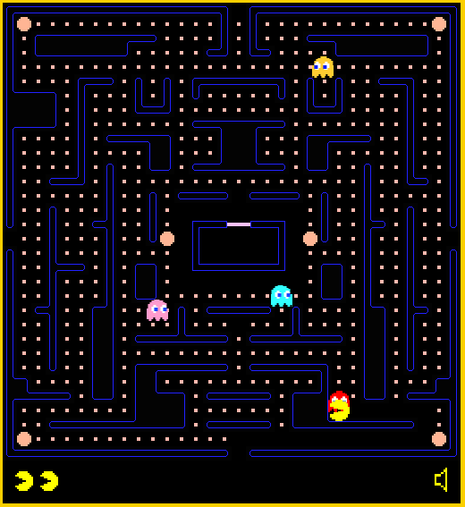
“Pacman”

Slide 3
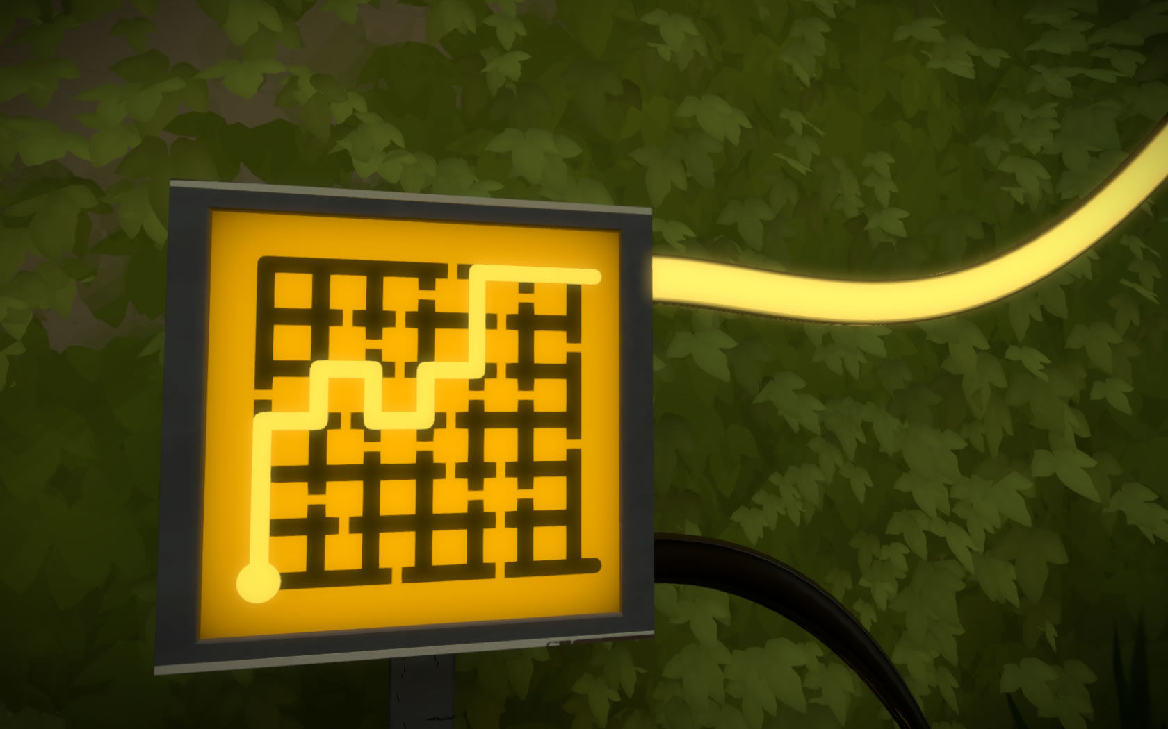
“The Witness”

Slide 4
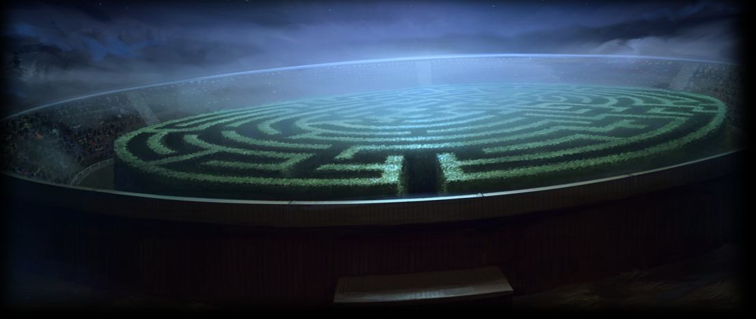
“Harry Potter”

Slide 5
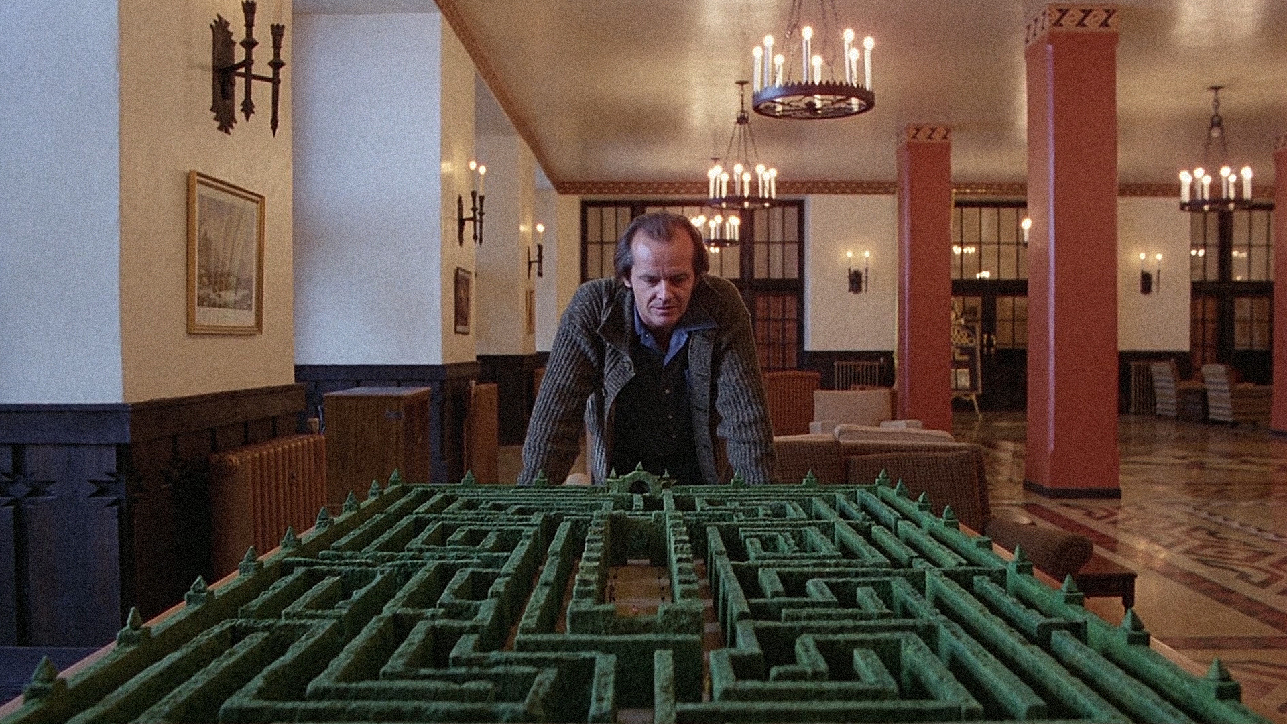
“The Shining”

Slide 6
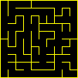
Terms
Perfect – Every cell can reach every other cell by exactly one path
No Loops
No self intersections
‘Spanning Tree’
Braid
Loops, intersections
We won’t build these today
Texture – The ‘feel’ of the maze
Bias – If the maze favours a given direction / shape

Slide 7
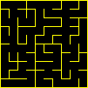
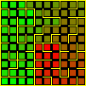
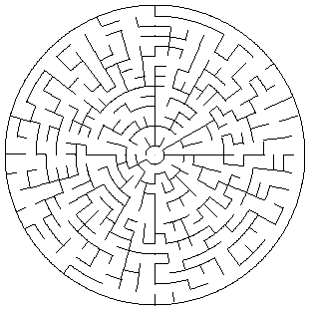
Today
Generate mazes
Binary Tree
Random Walk
Visualize ‘Texture’
Use a simplified Djikstra algorithm to find cell distances
Display distance as color
Compare the algorithms
(Harder)
Generate Polar Maze with either of the above

Slide 8
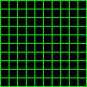
Structure
Think about a grid of cells, and how to represent them
Links between cells
Cell->neighbours[4]
Cell->holes[4]
Grid
Cells[Width][Height]
Coordinates
x, y
0,0
1, 0
0,1
1,1

Slide 9
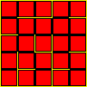
Drawing
ASCII Art
X0X00X
X00X00
X00000
https://github.com/YorkCodeDojo/mazes
Drawing Lines, Circles, Arcs, Boxes to Bitmap in cross-platform C++
Drawing Lines, Circles, Boxes to screen F#, C#
http://www.nerdparadise.com/tech/python/pygame/basics/part1
Python game library
pygame.draw.rect(screen, (0, 128, 255), pygame.Rect(30, 30, 60, 60))
Edges & Boxes

Slide 10
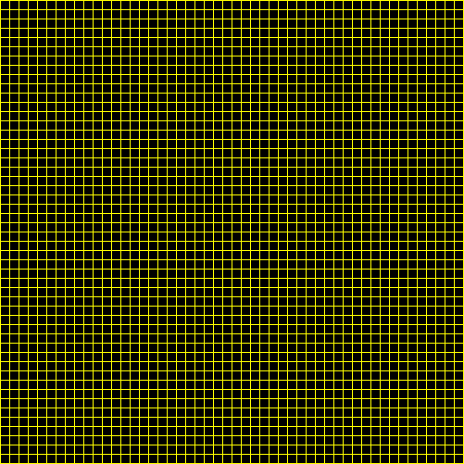
First, draw this….

Slide 11
Part 1 - Binary Tree Maze Generation
Visit all cells, in any order
Make a wall in either the east or north side (random)
Pick ‘the other’ wall if you are at an edge
Draw it!
How does it look?
Any obvious features?
Run the algorithm a few times to get a feel.

Slide 12
Part 2 – Random Walk Maze Generation
Start at a random cell
Pick a random direction to walk in (skip edge cases)
Have you never visited the target cell?
Make a hole and walk through it.
Otherwise - walk in anyway, but don’t make a hole
Keep going until all cells have been visited
Draw it
How does this compare to Binary Tree?

Slide 13
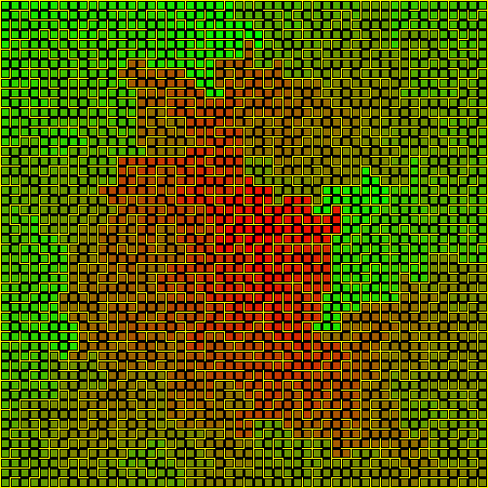
Part 3 - Visualizing Maze Texture
Set CurrentDistance = 0
Make a ‘list’ of cells
Add the center cell
Set all cells in list to CurrentDistance
For each cell, walk through all open walls
Add all destination cells to the list
CurrentDistance + 1
Repeat from 4
Generate color value based on distance
“Flood Filling”

Slide 14
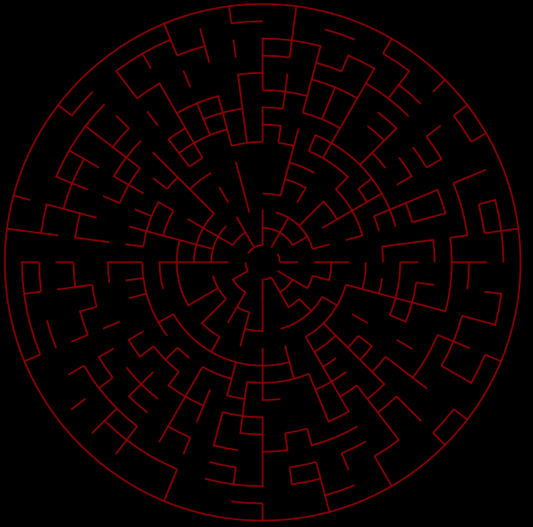
Part 4 – Homework?
Coordinate system:
Ring, Sector – Polar
Challenges:
Subdividing the rings (otherwise looks bad)
Drawing arcs/Circle?
Some cells have 2 exits rimward…

Slide 15
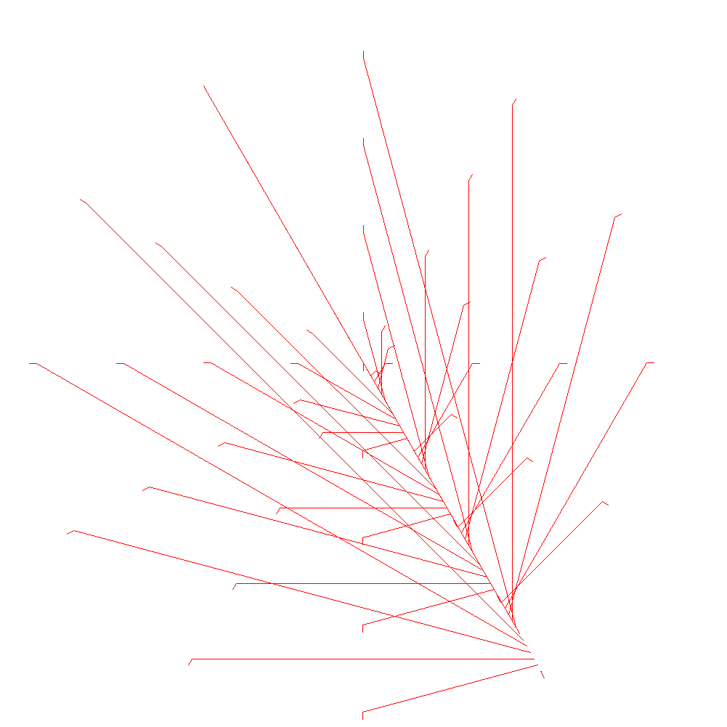
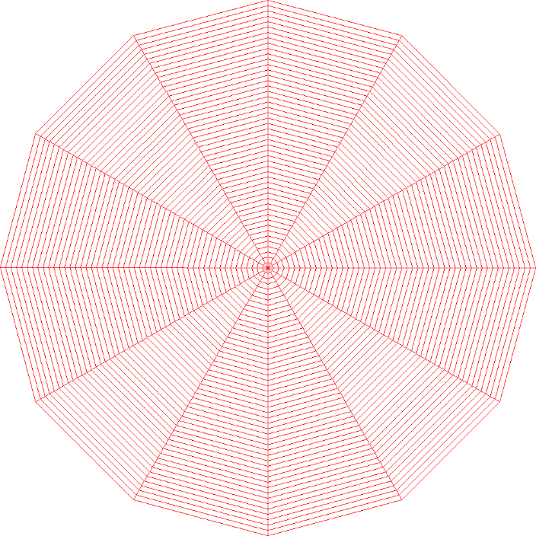
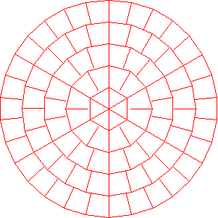
Results….
www.yogile.com/mazes (You don’t need an account)
Bloopers too!

Slide 16
Thanks
Doug/Isotoma for the Pizza, Drinks and Venue
David for the .NET drawing code

Slide 17
Meetups!
York Game Developers, 3rd Thursday, The Crown, York
http://www.meetup.com/York-Game-Developers/
York Code & Coffee – Wednesday 7AM+, Perky Peacock Lendal
http://www.meetup.com/York-Code-Coffee/
Leeds Code Dojo
http://www.meetup.com/Leeds-Code-Dojo/

Slide 18
Slack – York Developer Community
Mail me, David or Daniel to get on the group
yorkdevelopers.slack.com
For coders in the York area
Channels for #gamedev, #codeandcoffee, #yorkcodedojo,#development,….

Slide 19
Questions ?

